Slide 1
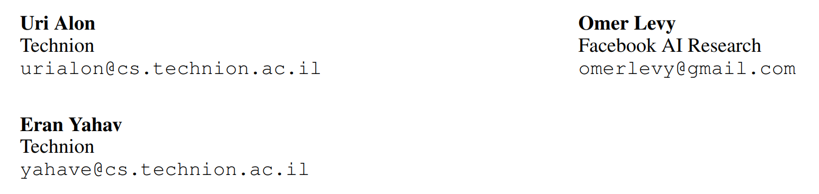
Code2seq: Generating Sequences From Structured Representations Of Code
Under review as a conference paper at ICLR 2019

Slide 2
01
Introduction
02
CONTENTS
Code Representation
03
Model Architecture
04
Experiments

Slide 3
01
Introduction

Slide 4
01
Introduction
Modeling the relation between source code and natural language can be used for automatic code documentation, retrieval, and even generation.
A direct approach is to frame the problem as a machine translation problem, where the source sentence is the sequence of tokens in the code and the target sentence is a corresponding natural language sequence.
We present an alternative approach for encoding source code that leverages the syntactic structure of programming languages: CODE2SEQ.
Represent a given code snippet as a set of compositional paths over its abstract syntax tree (AST), where each path is compressed to a fixed-length vector using LSTMs
Notes:
AST中部分路径的组合

Slide 5
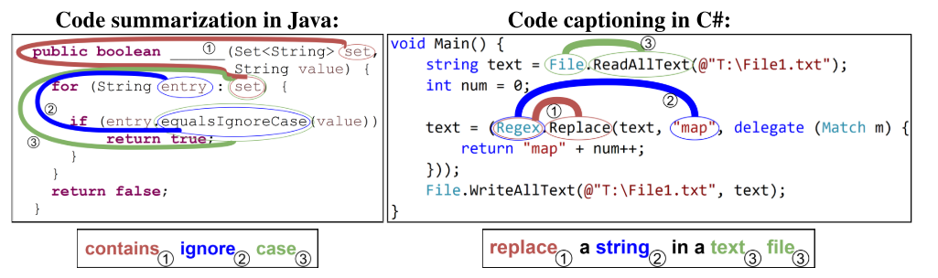
01
Introduction
Tasks
code summarization: where we predict a Java method’s name given its body
code captioning: where we predict a natural language sentence that describes a given C# snippet

Slide 6
02
Code Representation

Slide 7
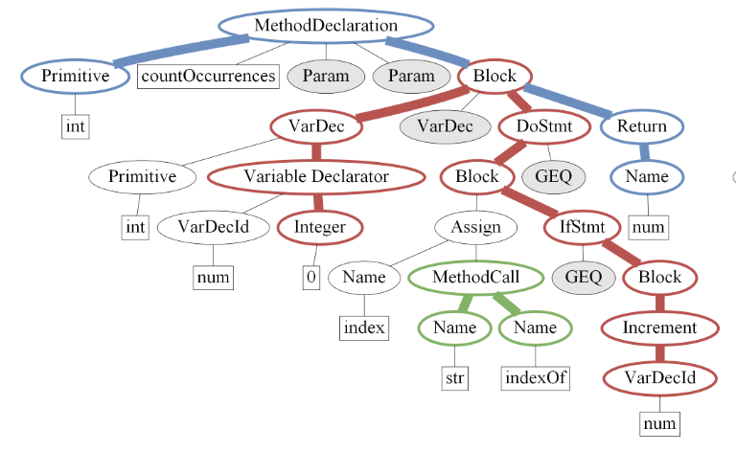
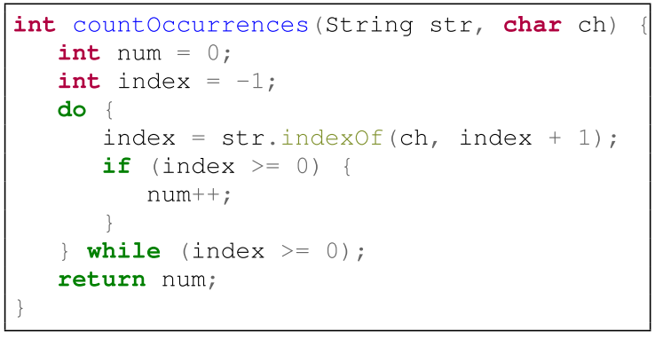
02
Code Representation
AST
An Abstract Syntax Tree (AST) is a tree which uniquely represents a source code snippet in a given language and grammar.

Slide 8
02
Code Representation
Given the AST of a code snippet, we consider all pairwise paths between terminals, and represent them as sequences of terminal and nonterminal nodes.
Then use these paths with their terminals’ values to represent the code snippet itself.
Since a code snippet can contain an arbitrary number of such paths, we sample k paths as the representation of the code snippet.
To avoid bias, k new paths are sampled afresh in every training iteration.
$\left\{\left(v_{1}^{1},v_{2}^{1},…,v_{l_{1}}^{1}\right), …,\left(v_{1}^{k},v_{2}^{k},…,v_{l_{k}}^{k}\right)\right\}$, where $l_{j}$is the length of the jth path
Notes:
每一对非终结符之间的路径

Slide 9
03
Model Architecture

Slide 10
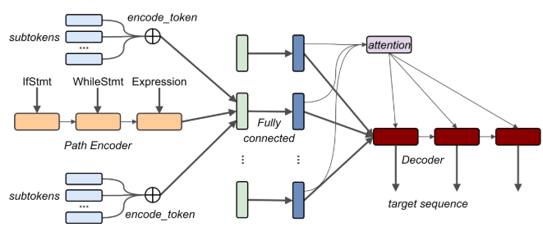
03
Model Architecture
The model follows the standard encoder-decoder architecture for NMT, with the significant difference that the encoder does not read the input as a flat sequence of tokens.
The encoder creates a vector representation for each AST path separately. The decoder then attends over the encoded AST paths (rather than the encoded tokens) while generating the target sequence.

Slide 11


03
Model Architecture
Encoder
We represent each path separately using a bi-directional LSTM to encode the path, and sub-token embeddings to capture the compositional nature of the terminals’ values (the tokens)
Path Representation We represent each node using a learned embedding matrix $E^{nodes}$ and then encode the entire sequence using the final states of a bi-directional LSTM:
Token Representation Split code tokens into subtokens, use a learned embedding matrix $E^{subtokens}$ to represent each subtoken, and then sum the subtoken vectors to represent the full token:
Combined Representation To represent the entire path x = v1...vl, we concatenate the path’s representation with each of the token representation of each terminal node, and apply a fully-connected layer:

Slide 12

03
Model Architecture
Decoder
Decoder Start State Average the combined representations of all the paths:
Unlike typical encoder-decoder models, the order of the input random paths is not taken into account. Each path is encoded separately and the combined representations are aggregated with mean pooling to initialize the decoder’s state.
Attention The decoder generates the output sequence while attending over the combined representations zi, ..., zk

Slide 13
04
Experiments

Slide 14
04
Experiments
Tasks
Summarization: Predict Java methods’ names from their bodies
Captioning: Generate natural language descriptions of C# code snippets

Slide 15
04
Experiments
Code Summarization
Task Details
Predict the target method name as a sequence of sub-tokens, e.g., setMaxConnectionsPerServer is predicted as the sequence “set max connections per server”
The target sequence length is about 3 on average.
Measure: precision, recall, and F1 score over the target sequence
Data
Java-small – Contains 11 relatively large Java projects[1]. We use the same data, but train and predict across projects: we took 9 projects for training, 1 project for validation and 1 project as our test set. This dataset contains about 700K examples.
Java-med – A new dataset of the 1000 top-starred Java projects from GitHub. We randomly select 800 projects for training, 100 for validation and 100 for testing. This dataset contains about 4M examples and we make it publicly available.
Java-large – A new dataset of the 9500 top-starred Java projects from GitHub that were created since January 2007. We randomly select 9000 projects for training, 200 for validation and 300 for testing. This dataset contains about 16M examples.
[1] A convolutional attention network for extreme summarization of source code

Slide 16
04
Experiments
Code Summarization
Baselines
Allamanis et al. (2016) who used a convolutional attention network to predict method names
Syntactic paths with Conditional Random Fields (CRFs) (Alon et al., 2018b)
code2vec (Alon et al., 2018a)
Three NMT baselines:
2-layer bidirectional encoder-decoder LSTMs (split tokens) with global attention
2-layer bidirectional encoder-decoder LSTMs (full tokens) with global attention
Transformer (Vaswani et al., 2017)
Miltiadis Allamanis, Hao Peng, and Charles A. Sutton. A convolutional attention network for extreme summarization of source code. In Proceedings of the 33nd International Conference on Machine Learning, ICML 2016, New York City, NY, USA, June 19-24, 2016, pages 2091–2100, 2016.
Uri Alon, Meital Zilberstein, Omer Levy, and Eran Yahav. code2vec: Learning distributed representations of code. arXiv preprint arXiv:1803.09473, 2018a.
Uri Alon, Meital Zilberstein, Omer Levy, and Eran Yahav. A general path-based representation for predicting program properties. In Proceedings of the 39th ACM SIGPLAN Conference on Programming Language Design and Implementation, PLDI 2018, pages 404–419, New York, NY, USA, 2018b. ACM. ISBN 978-1-4503-5698-5.
Ashish Vaswani, Noam Shazeer, Niki Parmar, Jakob Uszkoreit, Llion Jones, Aidan N Gomez, Łukasz Kaiser, and Illia Polosukhin. Attention is all you need. In Advances in Neural Information Processing Systems, pages 6000–6010, 2017.

Slide 17
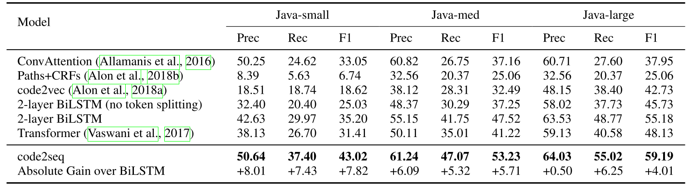
04
Experiments
Code Summarization
Results
Performance Significantly outperforms the baselines in both precision and recall across all the three datasets, demonstrating that there is added value in leveraging ASTs to encode source code.
Data Efficiency While the data-hungry NMT baselines require large datasets, our model can leverage both small and large datasets.
Notes:
included only a split token Transformer baseline.
(Allamanis et al., 2016) performed even better than the Transformer on the Java-small dataset, but could not scale and leverage the larger datasets. Paths+CRFs showed very low results on the Java-small dataset, which is expected due to the sparse nature of their paths and the CRF model.

Slide 18
04
Experiments
Code Captioning
Task Details
Predicting a full natural language sentence given a short C# code snippet.
Data
The dataset of CodeNN (Iyer et al., 2016), which consists of 66,015 pairs of questions and answers from StackOverflow.
The target sequence length in this task is about 10 on average.
Baselines
CodeNN, 2-layer bidirectional LSTMs with attention
Transformer
numbers from baselines used by Iyer et al. (2016)
Srinivasan Iyer, Ioannis Konstas, Alvin Cheung, and Luke Zettlemoyer. Summarizing source code using a neural attention model. In Proceedings of the 54th Annual Meeting of the Association for Computational Linguistics, ACL 2016, August 7-12, 2016, Berlin, Germany, Volume 1: Long Papers, 2016.

Slide 19
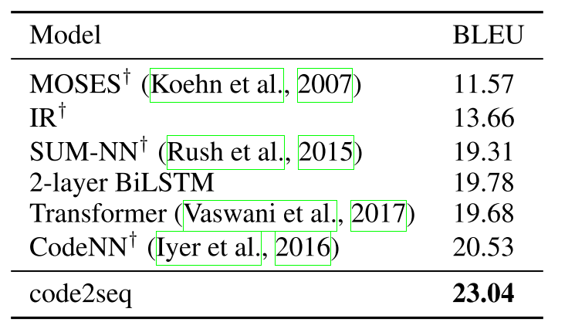
04
Experiments
Code Captioning
Results
When the training examples are short and incomplete code snippets, our model generalizes better to unseen examples than a shallow textual token-level approach, thanks to its syntactic observation of the data.

Slide 20
04
Experiments
Ablation Study
1. No AST nodes – instead of encoding an AST path using an LSTM, take only the first and last terminal values for constructing an input vector
2. No decoder – no sequential decoding; instead, predict the target sequence as a single symbol using a single softmax layer.
3. No token splitting – no subtoken encoding; instead, embed the full token.
4. No tokens – use only the AST nodes without using the values associated with the terminals.
5. No attention – decode the target sequence given the initial decoder state, without attention.
6. No random – no re-sampling of k paths in each iteration; instead, sample in advance and use the same k paths for each example throughout the whole training process.
These experiments were performed for the code summarization task, on the validation set of the Java-med dataset.

Slide 21
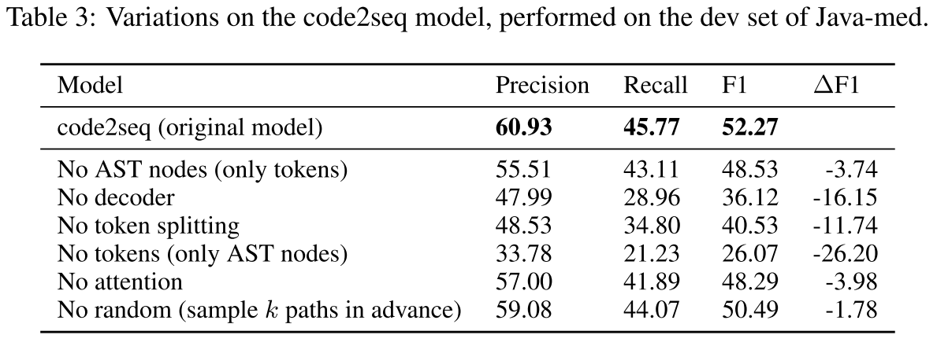
04
Experiments
Ablation Study

Slide 22
Thanks
Code2seq: Generating Sequences from Structured Representations of Code

